Slide 1


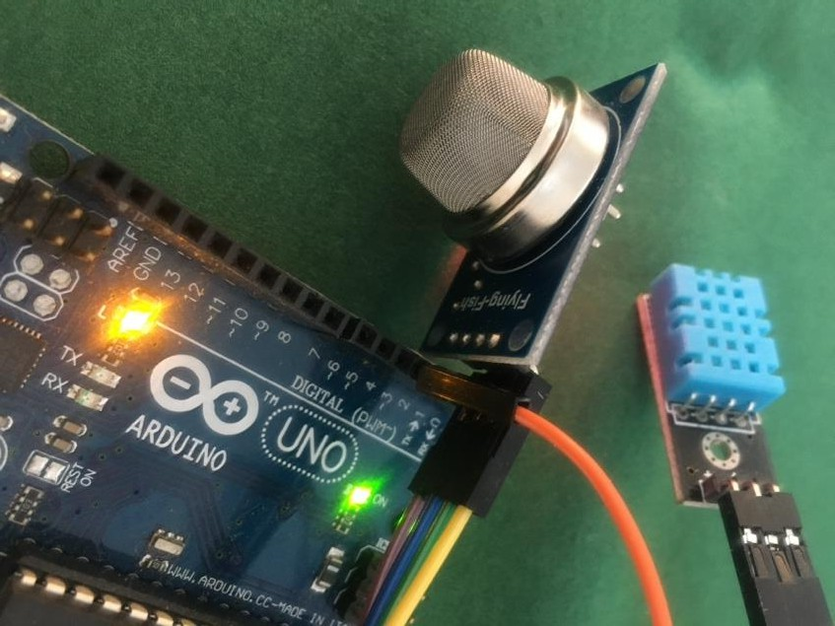
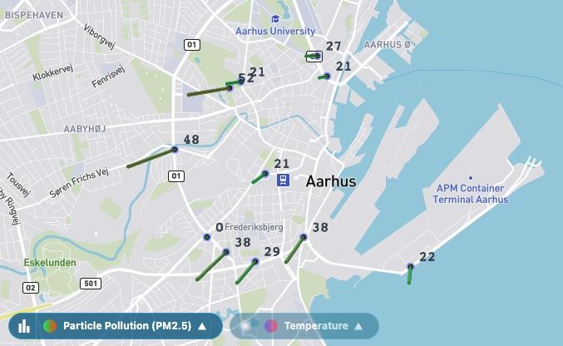
DATA ENGINEERING

Slide 2
Dagsorden
Flow intro
Webscrape intro
Web-trafik
HTML,CSS & JS
SMK-øvelse

Slide 3
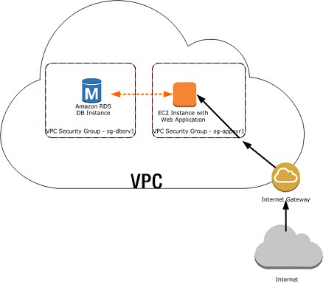

Bilbasen – Save data Infrastructure
Create EC2 instance
Get rdp-access
Install mysql
Client access
DBeaver
Dev access
RMariaDB

Slide 4
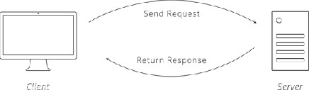
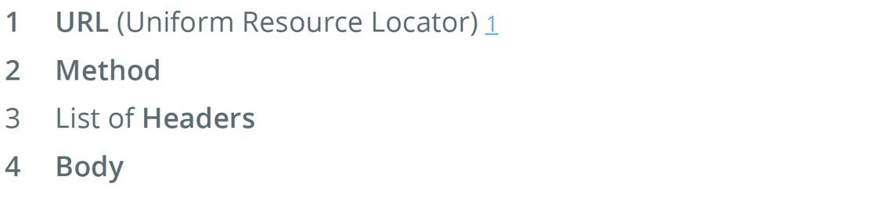
Protocols
Knowing the rules
Computers an etiquette as polite people, though it goes by the term "protocol." A computer protocol is an accepted set of rules that govern how two computers can speak to each other.
The Protocol of the Web
On the web, the main protocol is the Hyper-Text Transfer Protocol, better known by its acronym, HTTP.
HTTP Requests
Communication in HTTP centers around a concept called the Request- Response Cycle.
A valid request
HTTP Response
After the server receives a request from the client, it attempts to fulfill the request and send the client back a response. HTTP responses have a very similar structure to requests.

Slide 5

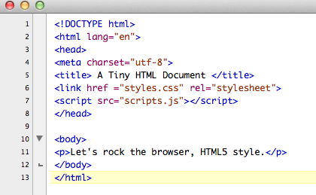



Slide 6
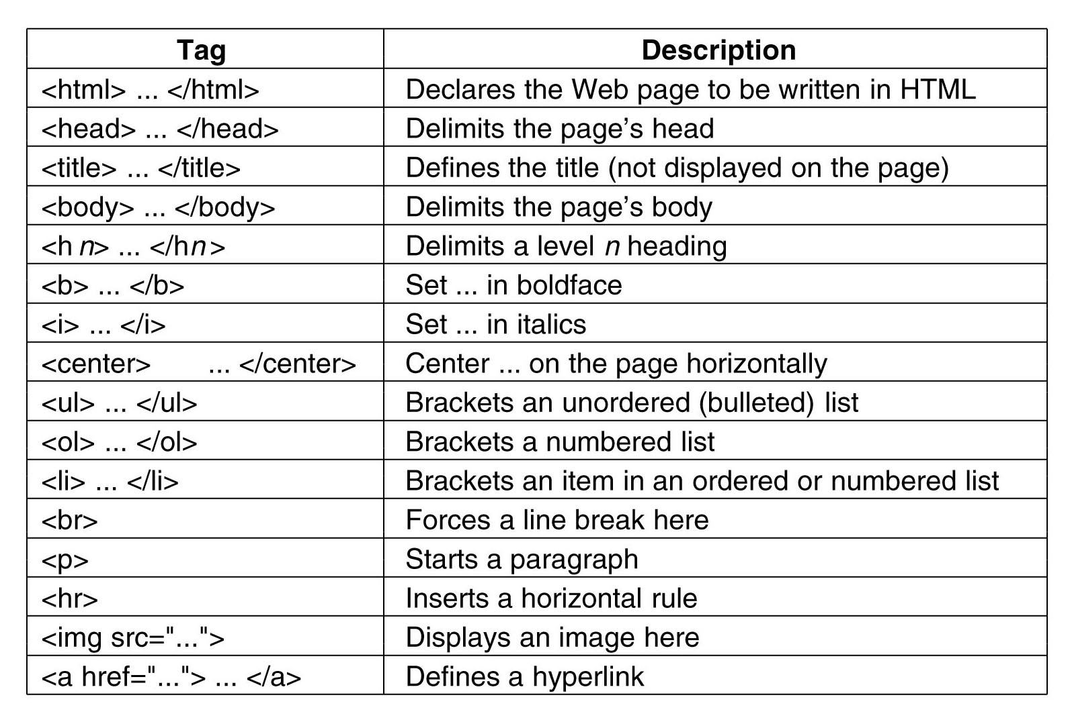

Slide 7
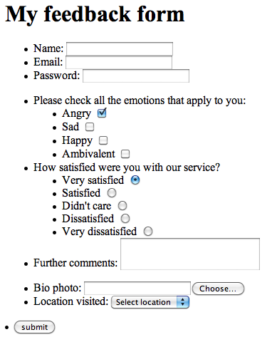

Slide 8
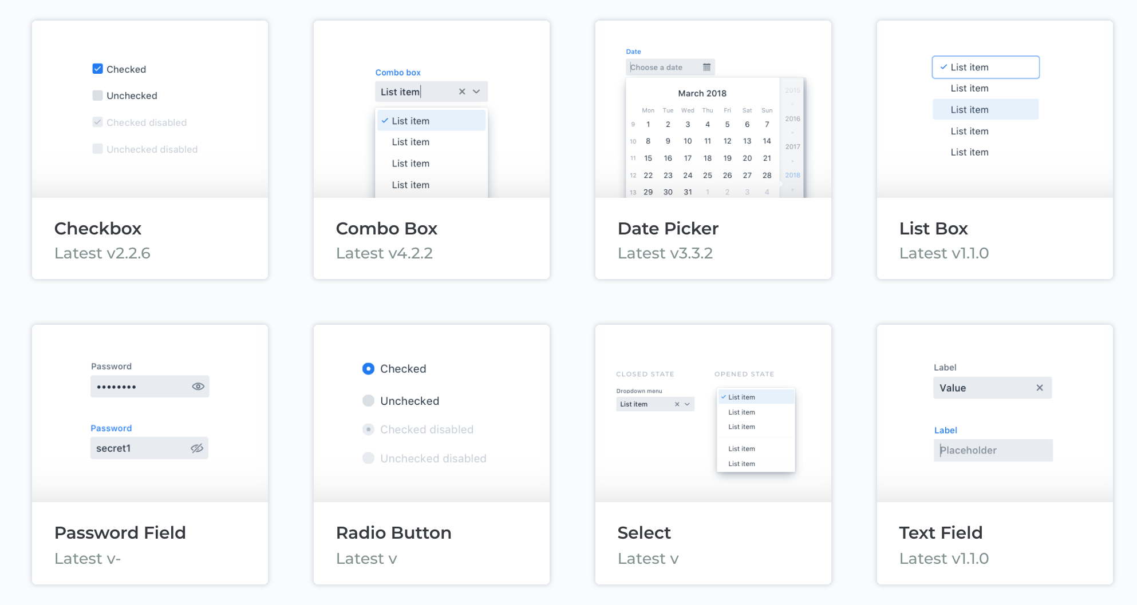


Slide 9
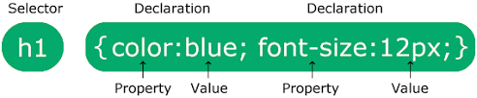
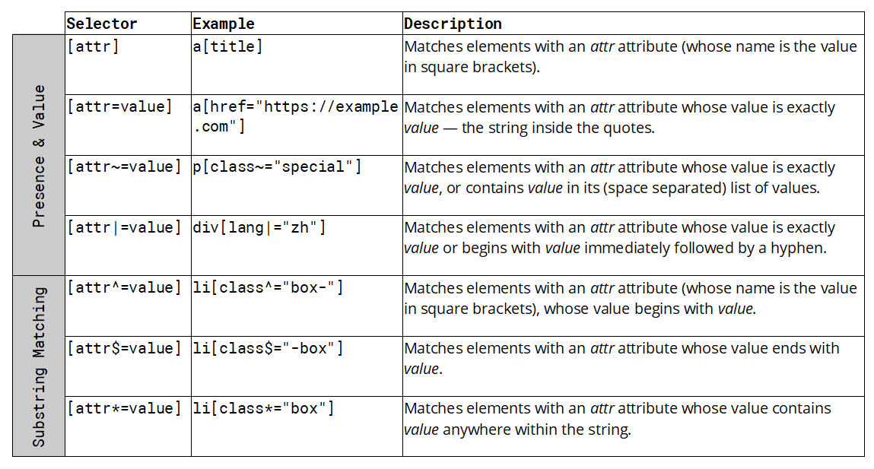
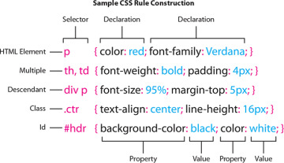

Slide 10
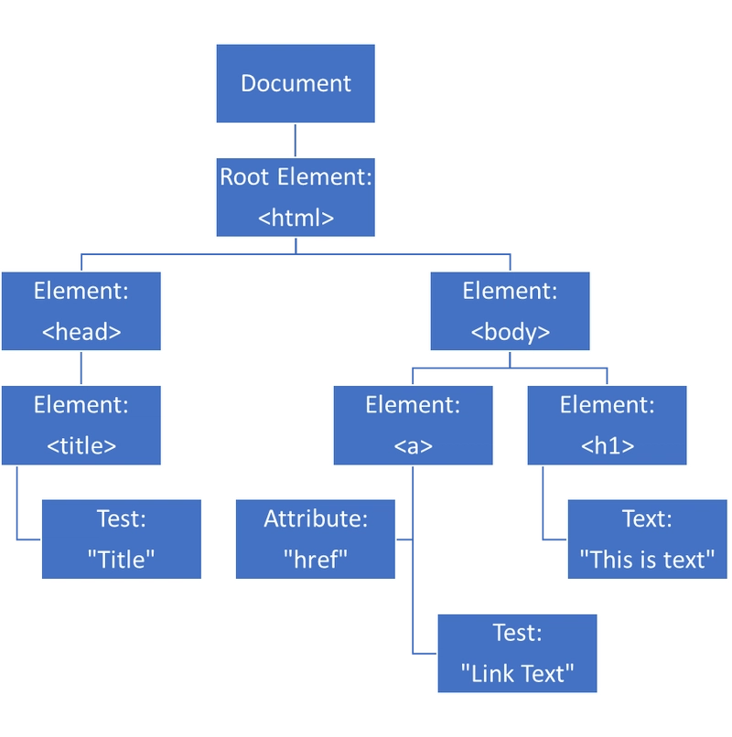
+

Slide 11
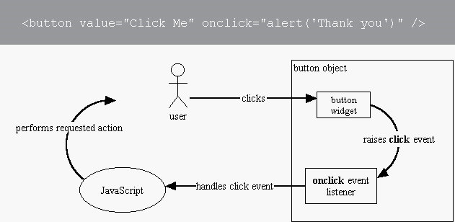
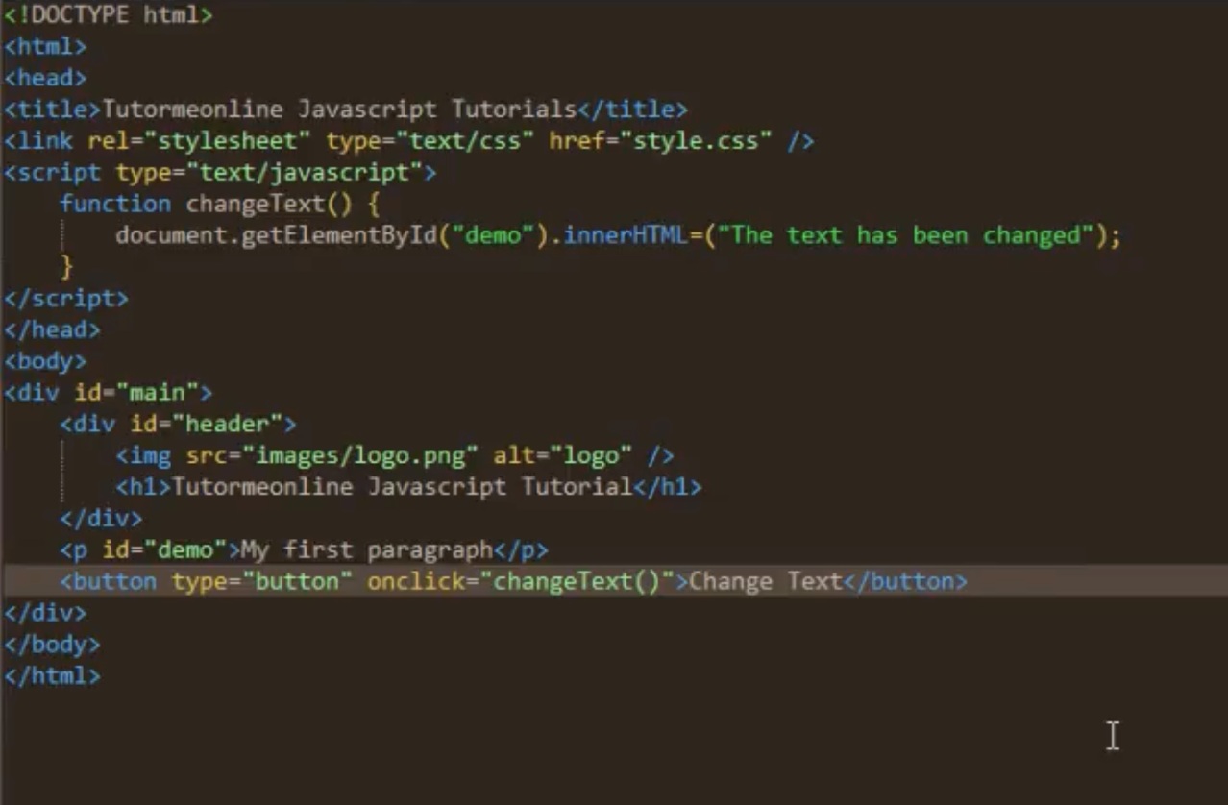
+

Slide 12
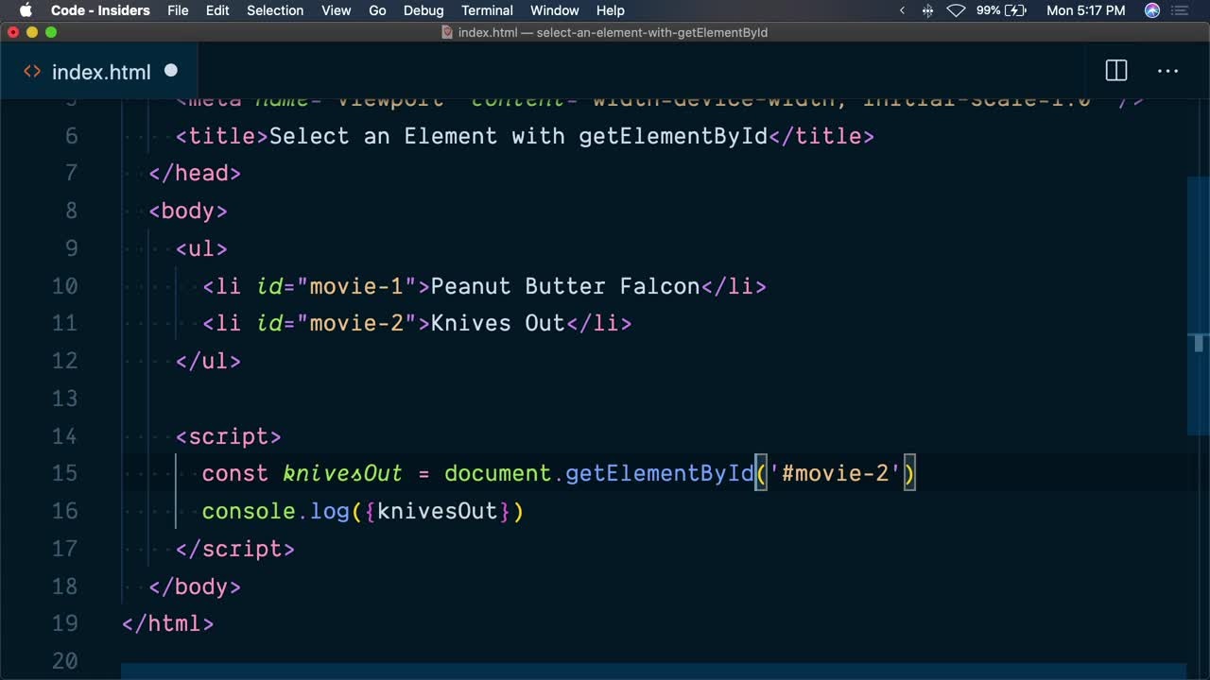
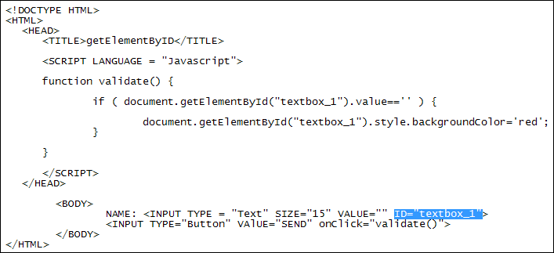
+

Slide 13
Øvelse
Hent tre malerier fra smk’s åbne api (se næste slide) fra middelalderen, guldalderen og efter 1900
hent billedet (thumbnail og highres)
hent relevante metadata (Kunstner, produktionsår, titel og køn)
lav en mockup på papir til en hjemmeside der skal vise billederne inkl metadata
Kod siden i html og style den med css
der skal være et link til billedets ”hjem” på SMK.dk
det skal lægges i tabeller eller i div’er
der skal være en lille like-knap så hvis man trykker på den sendes man til en side med titlen beskeden ”Tak for dit bidrag”

Slide 14

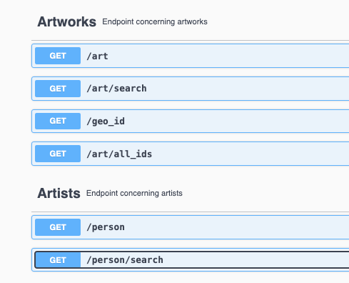
Data-retrieval CASE: SMK API
Find ud af hvor mange værker SMK har registreret af Jens Juel
Find swagger urlen
Kopier ind i R og udfør GET(url)
Hvor mange af dem er malerier?
filtrer på ”KMS” vha grepl
Hvornår blev de købt?
Lav en kommasepareret streng af alle KMS-værker
Find swagger urlen til denne søgning
Lav en dataframe ud fra et loop igennem listen med alle værker

Slide 15

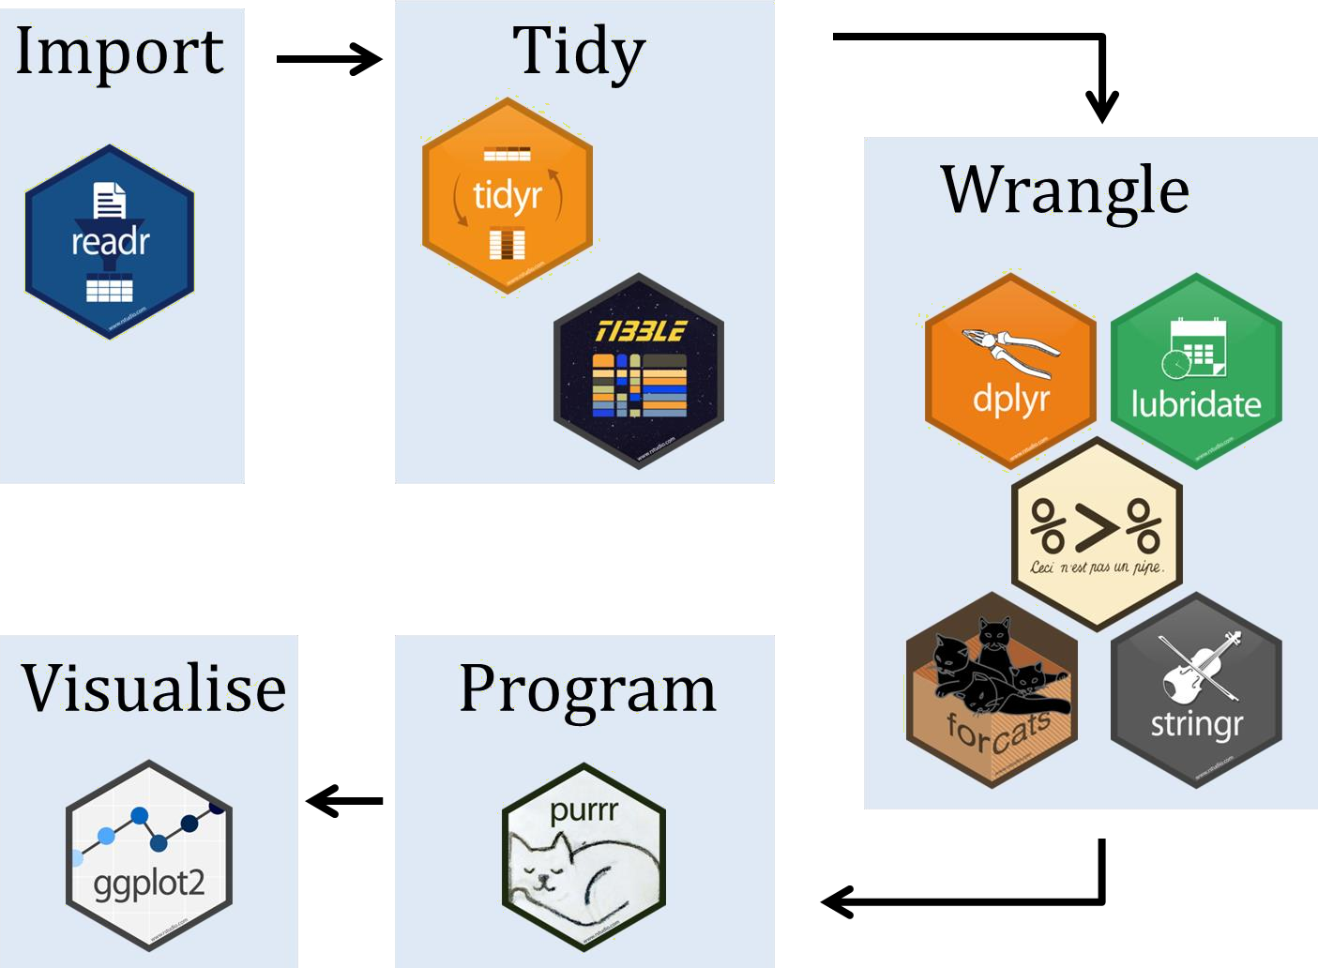


Bilbasen

Slide 16


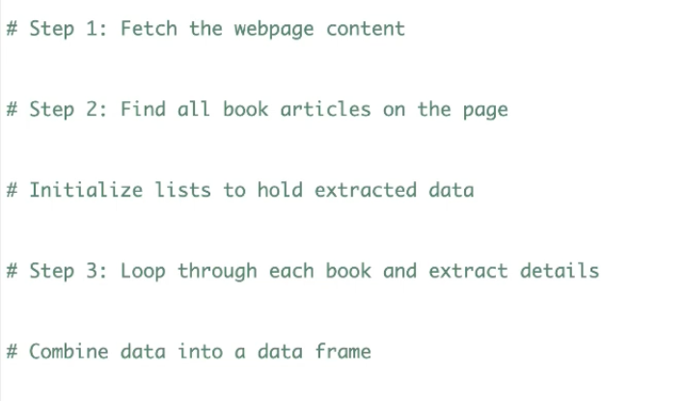
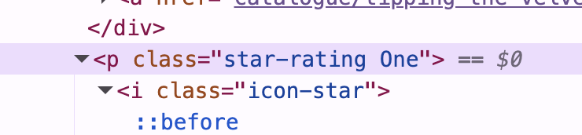
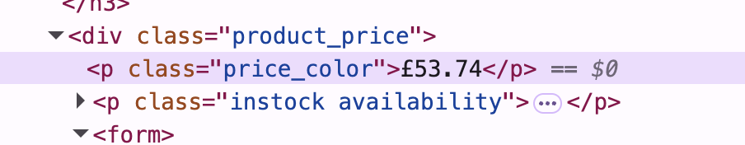
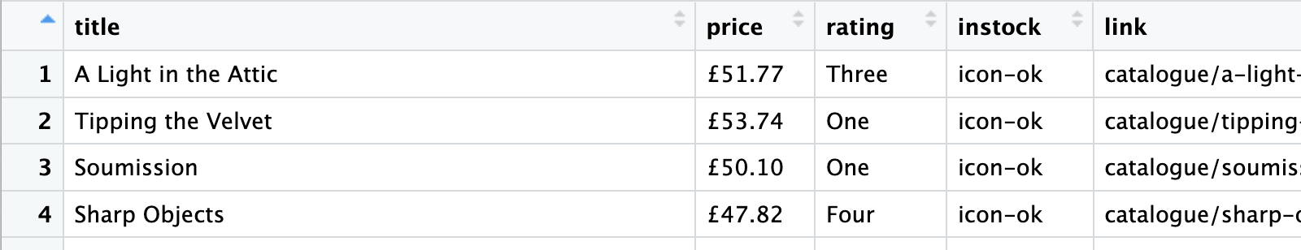
Ibtissam

Slide 17
Bilbasen
Read link with read_html(link)
Select parts of a document
CSS selectors: html_nodes(doc, "table td")
XPath selectors: html_nodes(doc, xpath = "//table//td")).
Extract components with
html_name() (the name of the tag),
html_text() (all text inside the tag),
html_attr() (contents of a single attribute) and
html_attrs() (all attributes).
Parse tables into data frames with html_table().
Navigate around with html_session()

Slide 18





Webscrape – flow
Analyse webpage structure
Find the start-link
read_html(link) select elements
extract data
load into data-frame
save to data-base
paging process - (rselenium)

Slide 19
Bilbasen
Read
read_html
Select
html_nodes
Extract
html_attr
html_text

Slide 20
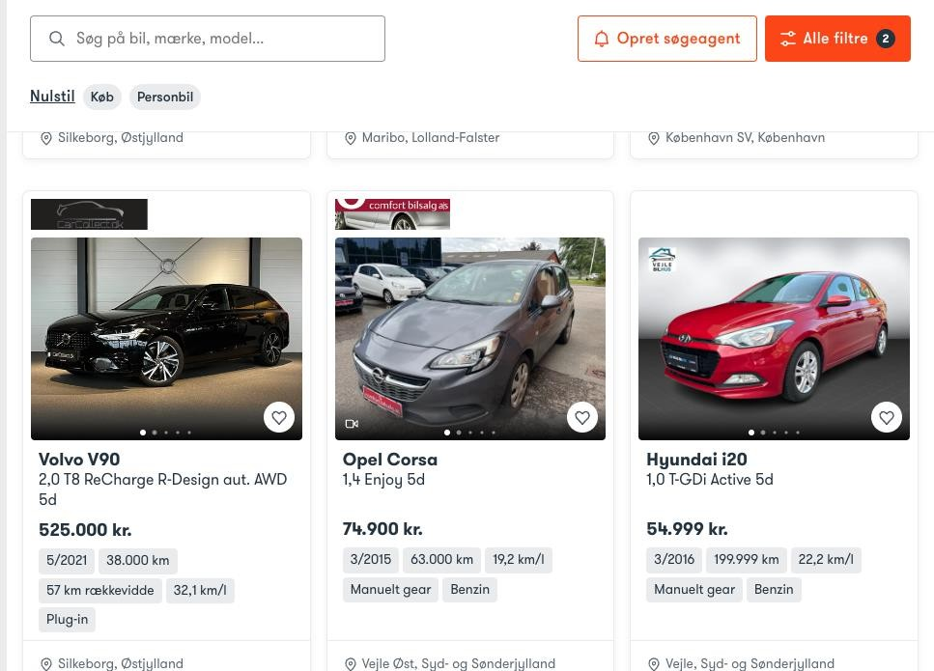

Slide 21



Webscrape – auto
One time run
Create search below limit
Setup AWS server to run RScript Setup Database for results
Setup cron-job
load into data-frame
save to data-base

Slide 22
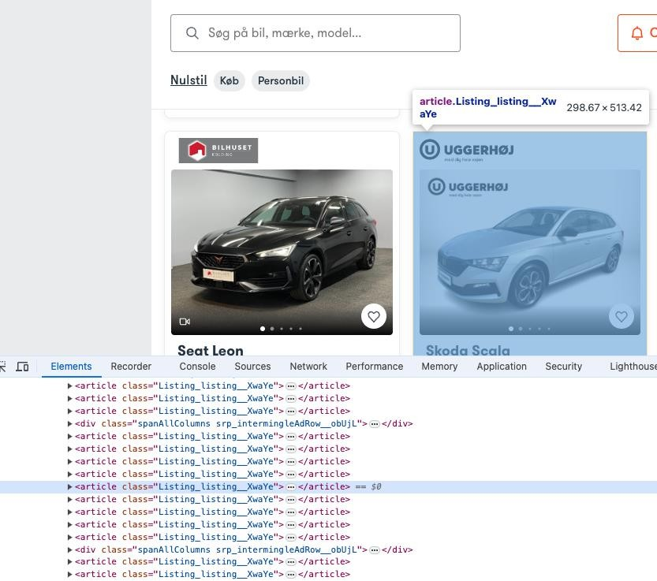
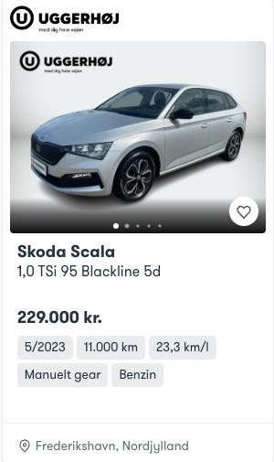

Slide 23
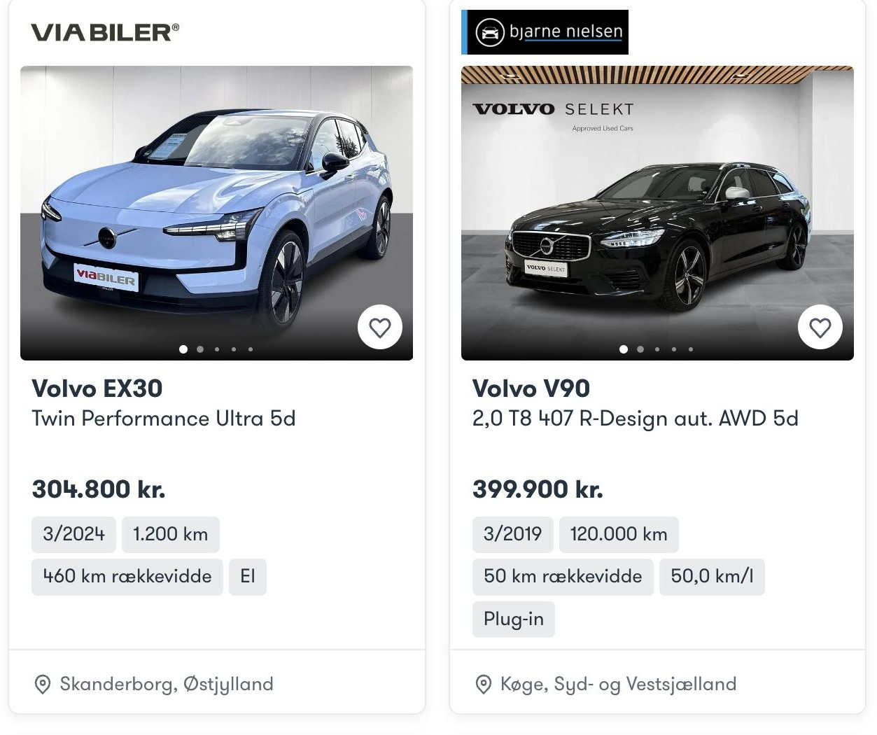
Forhandler
Make
Type
Displ
Description
Price
Milage
Year
Fuel
Seller
Region

Slide 24
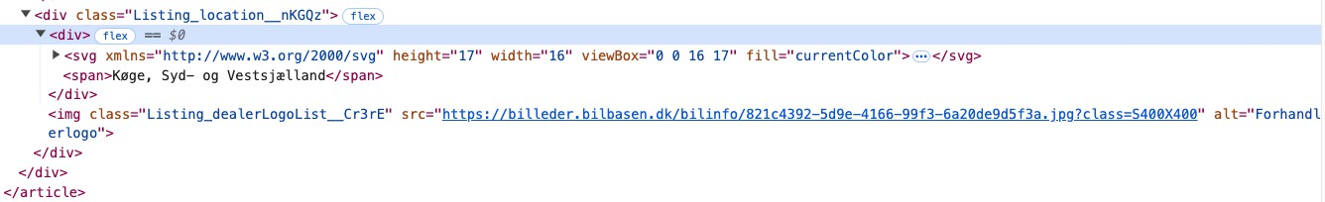
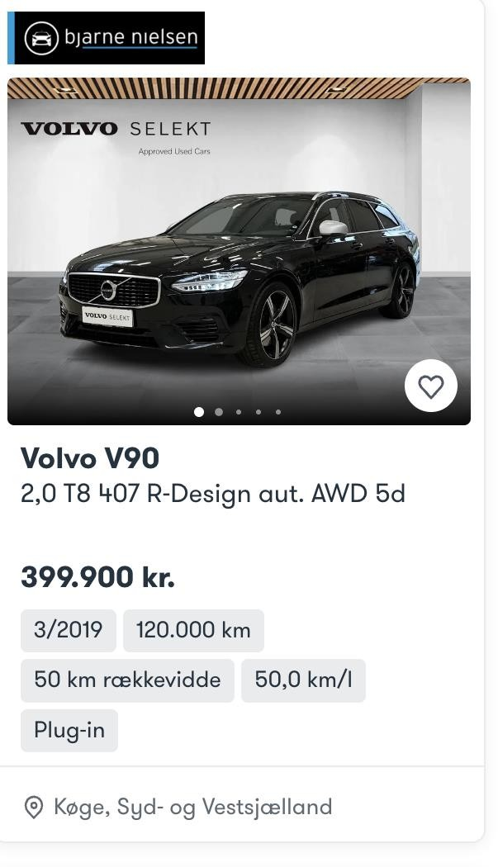
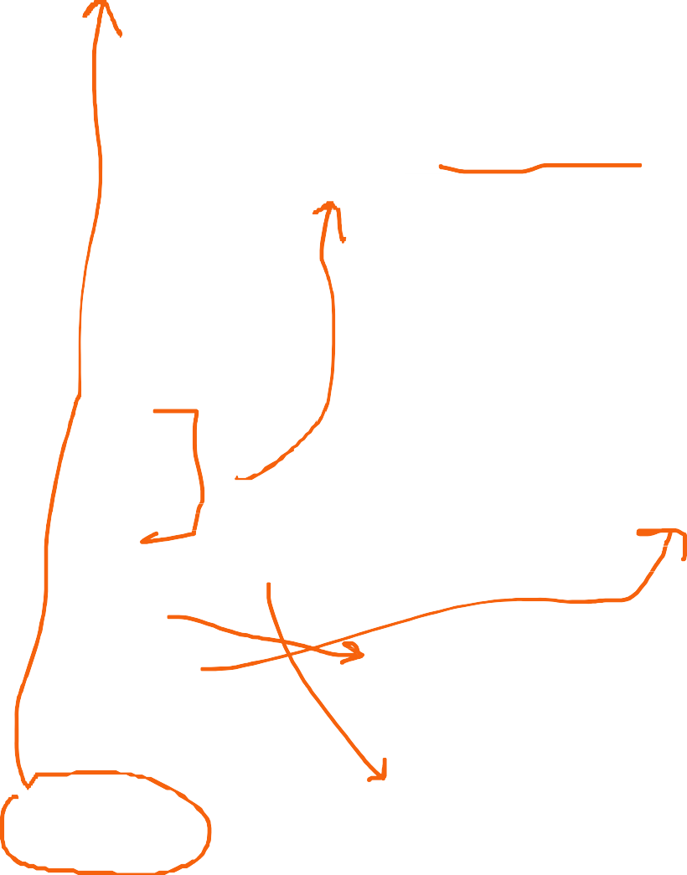
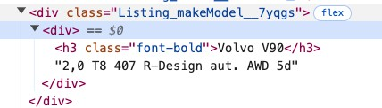
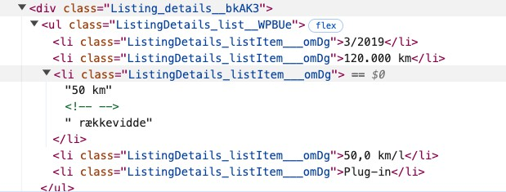
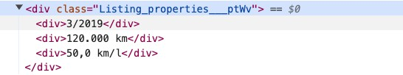
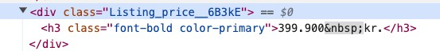
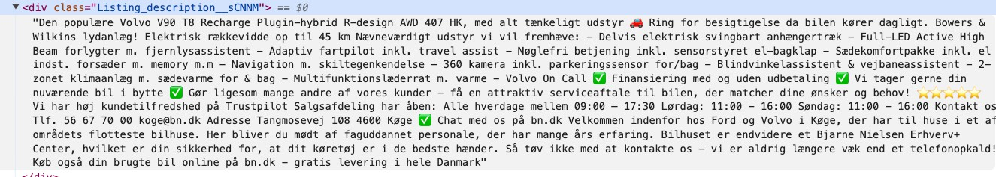
Forhandler
Make
Type
Displ
Description
Price
Milage
Year
Fuel
Seller
Region

Slide 25


Bilbasen
get version of chrome
chrome://version/ -> 106.0.5249.103
get the matching chrome-driver
https://sites.google.com/chromium.org/driver/downloads
Install rselenium-package (and java JDK)
Instantiate the driver: rD = rsDriver()
get the client: rcD = rD[[”client”]]
navigate to site: rcD$navigate(link)
get the page-source:source=rcD$getPageSource()
Bilbasen
html = read_html(source[[1]])
Leave JS (selenium) for CSS & HTML

Slide 26
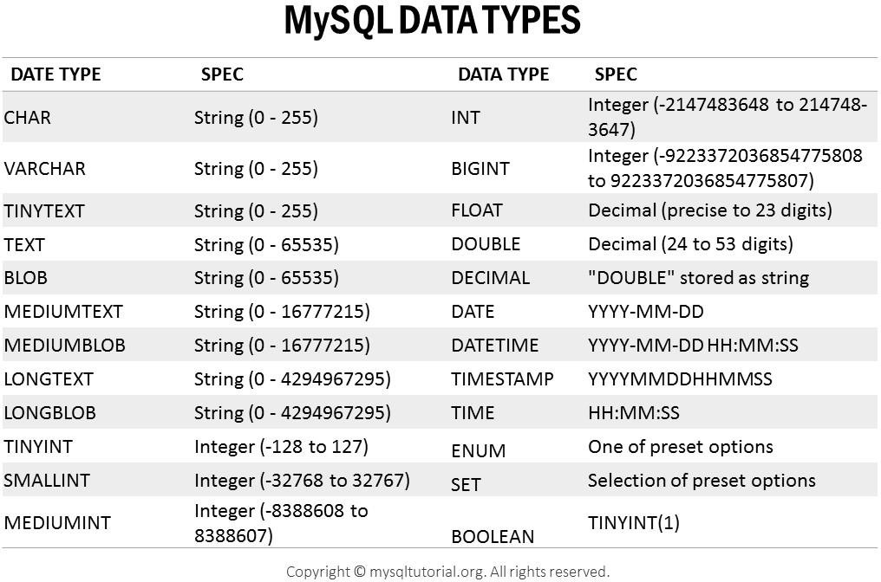
Bilbasen – hvilke data?
Make - string
Type - string
Kmpl - int
Km - int
Year - int
Price – int
Nprice – int
EngineType – F
Width
Length
Height
Cyl
Color - string
Doors - int
Description - text
Id - int
Images – link?

